Slide 2
Indigenous Health
Health Information Science 140
University of Victoria

Slide 3
Indigenous Health
Objectives: Part 1
Describe the impact of colonization on indigenous peoples
Describe the demographics of indigenous peoples
Describe the health challenges of indigenous peoples
Describe health care policy and health care delivery to indigenous peoples
Describe the role of Indigenous services

Slide 4
“The world will not be destroyed by those who do evil, but by those who watch them without doing anything.” (Albert Einstein)

Slide 5
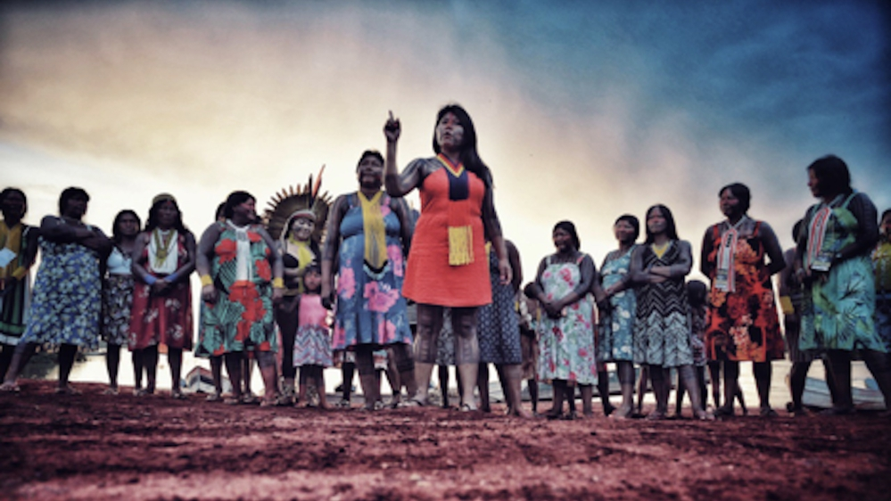
Indigenous peoples
The term 'Aboriginal' or 'Indigenous' used on the Statistics Canada website refers to individuals identifying themselves as 'First Nations people, Métis or Inuit'.

Slide 6
Multiculturalism
1971: Government of Canada declared its commitment to multiculturalism and later, explicitly incorporated it into the Charter of Rights and Freedoms.
1981: The Constitution was repatriated in response to aboriginal groups’ exclusion; it included the Canadian Charter of Rights and Freedoms.
Canada is an immigrant nation where, different than the United States (thought of as a ‘melting pot’), Canada refers to the ‘Canadian mosaic’.
Different immigrant groups retain substantial elements of cultural identity while still participating in Canadian civil society, sharing common values.

Slide 7
Multiculturalism
1985: Multiculturalism Policy of Canada – Declared to be the policy of the Government of Canada to:
Recognize and promote the understanding that multiculturalism reflects the cultural and racial diversity of Canadian society and acknowledges the freedom of all… to preserve, enhance, and share their cultural heritage;
Recognize and promote the understanding that multiculturalism is a fundamental characteristic of the Canadian heritage… provides an invaluable resource in the shaping of Canada’s future.
Promote the full and equitable participation of individuals and communities of all origins in the continuing evolution…
19 additional policies – see Canadian Multicultural Act (1985)

Slide 8
Canadian Indigenous populations
Indigenous peoples refers to 3 groups:
First Nations
Métis, and
Inuit
Much of Canada’s cultural, economic and political landscape has been shaped by the achievements of Indigenous peoples.
Indigenous leaders, elders, healers, educators, business leaders, artists, activists have made invaluable contributions that touch all aspects of life in Canada.

Slide 9
Indigenous populations
Aboriginal people (‘aboriginal’ synonymous with indigenous) are recognized as one of the 3 founding nations.
First Nations, Métis, and Inuit were first, playing a key role in the creation of Canada.
The aboriginal population is diverse and widespread; each share some common cultural characteristics but many are not common among the different peoples.
Government policy has created divisions within the aboriginal peoples, reflecting existing cultural and social divides usually based on eligibility for government programs.

Slide 10
First Nations
First Nations are peoples who reside below the Arctic. They are part of a continuum of peoples who despite social, linguistic and cultural diversity stretch from boreal Canada to South America.
In Canada, First Nations are divided into 2 groups: Status and Non-status.
‘Status Indians’
Recognized by the Department of Aboriginal Affairs as legal members of an existing First Nations band.
They are the largest group, estimated at about 565,000.
Status means eligibility for certain government programs; some are specific to treaty rights.

Slide 11
First Nations
‘Status Indians’
A ‘status card’ provides some privileges, e.g., income tax exemption for those on reserves.
Those living off-reserve have the same rights and responsibilities as other Canadians.
Eligibility is determined through ancestry, not through blood.
Status is gained through inheritance of status itself. Note: Individuals must marry another status person for their children to inherit it.
Historically, Indian status brought more restrictions than privileges. For example: required to live on reserves, subject to movement restrictions, barred from voting, not allowed to drink alcohol, closely supervised by Indian agents on reserves.

Slide 12
First Nations
‘Status Indians’
They were wards of the state, with status similar to children. The restrictions could only be removed by giving up status, leaving the reserve and assimilating into the general population.
‘Non-status Indians’
These are people (approximately 130,000) of aboriginal ancestry who self-identify as First Nations but cannot claim status.
Reasons vary for self-identified First Nations not being able to claim status: Common reasons include ancestors voluntarily having given up status, females losing status by marrying non-First Nations, and lack of documentation.
Non-status peoples are not eligible for government programs or services provided for status Indians.

Slide 13
First Nations
‘Non-status Indians’
Do not have the right to reside on First Nations reserves.
However, government recognition has no bearing on their participation in aboriginal culture and society.
Status vs. Non-status
The existence of status and the right of Canadian governments to decide who is aboriginal or not is very contentious.
Recently, federal and provincial/territorial governments have extended various services to non-status peoples without formal status or access to services.
Many are reclaiming their heritage and identity even without the benefits of status.

Slide 14
Inuit
Inuit are peoples inhabiting Canada’s High Arctic.
They are closely related to indigenous peoples in high arctic regions in other countries, such as in Greenland, Alaska, and the Russian arctic.
Inuit comprise the majority of the population in Nunavut, Canada’s newest territory, and in the Northwest Territories, northern Quebec, and northern Labrador.
Collectively across these Canadian regions, they are referred to as Inuit Nunangat.

Slide 15
Métis
The population is approximately 400,000.
Métis are descendants of marriages between aboriginal women, and fur traders and explorers.
Traditionally, the origin of the Métis was in the Red River settlement of the Hudson Bay Company, and also the largest settlement.
Many settlements spread across Canada, wherever trading posts emerged.
A hybrid culture evolved from mixed ancestry combining First Nations and Europeans.
In 1967, the government recognized the Métis as a distinct people.
They survived the Northwest Rebellions (1869-1885).

Slide 16
Canadian Indigenous demographics
The Indigenous population is much younger than the non-Indigenous population.
Indigenous peoples, at about 1,800,000, comprise about 5% of Canada’s population.
The Indigenous population in Canada grew by 9.4% between 2016-2021.
First Nations population:
Approximately 1,050,000; grew by 9.7% from 2016-21.
753,000 with registered treaty Indian status. 41% lived on reserve, 59% off-reserve.
Métis:
Approximately 624,000; grew by 6.3% from 2016-21.
About 225,000 are members of Métis organizations or settlements.

Slide 17
Indigenous demographics
Inuit:
Approximately 71,000; grew by 8.5% from 2016-21.
The majority (69%) live in Nunangat.
Reasons for growth
Natural growth: higher birth rates and increasing longevity.
Response mobility: refers to people who responded differently over time to Indigenous identity; some who previously did not identify as Indigenous now do.
Canada’s Indigenous population is one of the largest countries that share a similar colonial history – more than double than in Australia and the number of Maori in New Zealand.

Slide 18
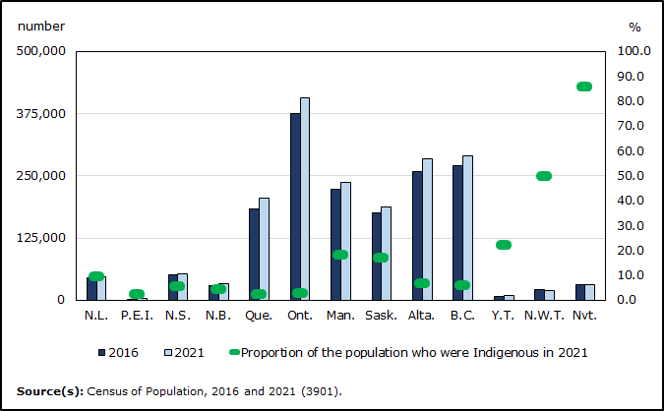
Over 1.8 million Indigenous people counted in the 2021 Census Most Indigenous people live in Ontario and Western Canada, but account for larger share of overall population in territories

Slide 19
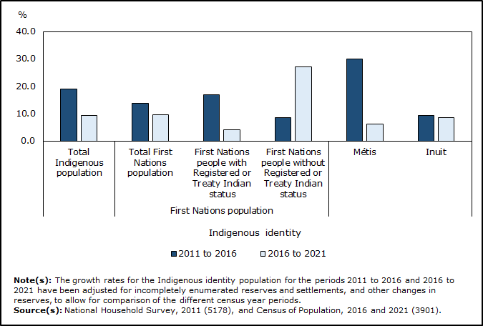
Indigenous population still growing faster than non-Indigenous population, but pace of growth has slowed. Population growth slows in 2021 among First Nations with Registered or Treaty Indian status, Métis and Inuit, compared with five years earlier

Slide 20
Where are First Nations people living?
In 2021, 4 in 10 First Nations people with Registered or Treaty Indian status lived on reserve.
Note: ‘On reserve’ refers to census subdivisions legally affiliated with bands. However, while this definition applies to some First Nations that have signed a modern treaty or a self-government agreement, it does not apply to all. For example, most First Nations in the Northwest Territories and Yukon have signed modern treaties, but their administered lands are not considered on reserve.
Regionally, more than half (55.5%) of all First Nations people lived in Western Canada, and 7.6% resided in Atlantic Canada.
Provincially, Ontario had the largest number of First Nations people (251,000), making up nearly one-quarter (23.9%) of Canada’s First Nations population. 11.1% lived in Quebec. The remaining 1.9% of First Nations people lived in the territories.
Almost three-quarters (71.8%) of First Nations people had Registered or Treaty Indian status under the Indian Act, while 28.2% did not.

Slide 21
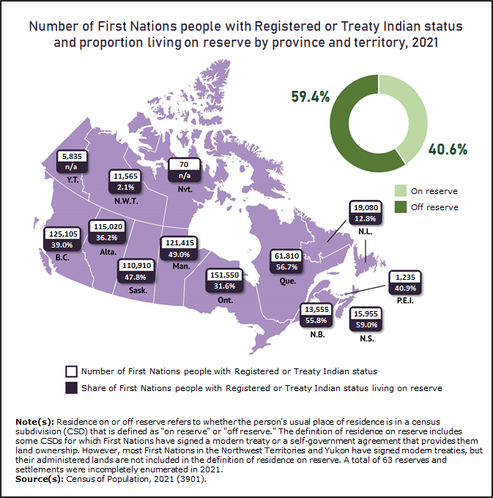

Slide 22
Distribution of Métis population
In 2021, over four in five Métis (83.2%) lived in either Ontario or Western Canada.
Provincially, Ontario had the largest Métis population (135,000), followed by Alberta (127,000).
The Métis Nation of Alberta had the largest membership reported among Métis organizations, at 45,350 in 2021, followed closely by the Manitoba Metis Federation, at 43,920, and then by the Métis Nation of Ontario (36,240), Métis Nation British Columbia (27,140) and Métis Nation—Saskatchewan (26,700).
Along with Métis organizations, there are eight Metis Settlements of Alberta that were established though the 1938 Métis Population Betterment Act of the Alberta Legislature. These communities, located across central and northern Alberta, are the only land base for Métis officially recognized by a provincial government.

Slide 23
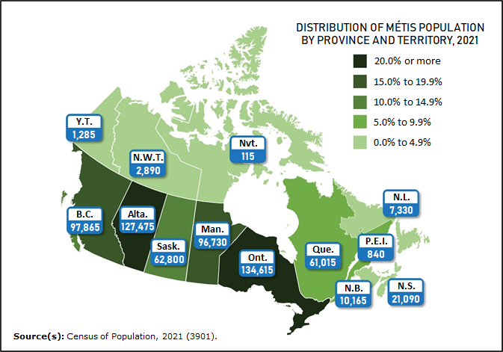
Métis population in Canada grows at much slower pace in 2021, compared with five years earlier

Slide 24
Distribution of Inuit population
In 2021 there were 70,545 Inuit living in Canada, up 8.5% from five years earlier.
Nunavut is home to the largest Inuit population in Canada, while the number of Inuit living outside Inuit Nunangat on the rise.
Inuit Nunangat: The homeland of Inuit in Canada is composed of four regions:
The westernmost is the Inuvialuit region, found in the north of Yukon and the Northwest Territories.
Next to it is Nunavut, Canada's third territory, which was officially established in 1999.
Nunavik—the second most populated region—is located along the western and northern coastline of Quebec.
Nunatsiavut is found along the north coast of Labrador.
Just over four-fifths (80.6%) of Inuit in Canada reported that they were enrolled under or were a beneficiary of an Inuit land claims agreement. The largest group of claimants (33,310 people) was part of the Nunavut Land Claims Agreement, and most (88.4%) of this group lived within the territory of Nunavut.

Slide 25
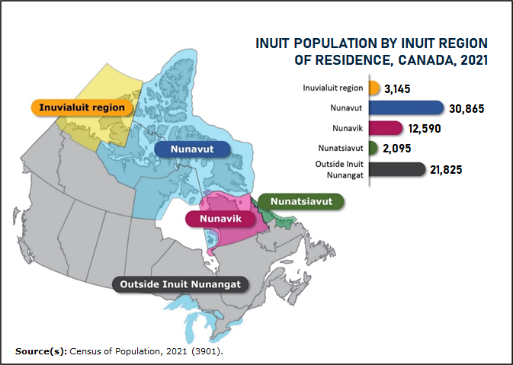
Nunavut home to largest Inuit population in Canada, while number of Inuit living outside Inuit Nunangat on the rise

Slide 26
Indigenous populations’ growth in large urban centres
In 2021, 3 in 4 Canadians lived in a large urban centre (of at least 100,000 people). 801,000 Indigenous people lived in large urban centres.
Indigenous people were more likely to live in a large city in 2021 than in 2016.
Over this five-year period, the Indigenous population living in a large urban centre grew by 12.5%.
Within the total Indigenous population, the share of Indigenous people living in a large urban centre rose from 43.1% to 44.3%.
In some cases, Indigenous people—particularly those who live in remote, northern settings—may live temporarily in a large urban centre to access medical care
In 2021, Winnipeg had the largest Indigenous population (102,080), followed by Edmonton (87,605) and Vancouver (63,345).
From 2016 to 2021, the Indigenous population grew most in Edmonton (15.0%), Montréal (32.4%) and Winnipeg (9.4%). While the Indigenous population grew in most large urban centres over the same period, it declined slightly in Toronto (by 3.6%).

Slide 27
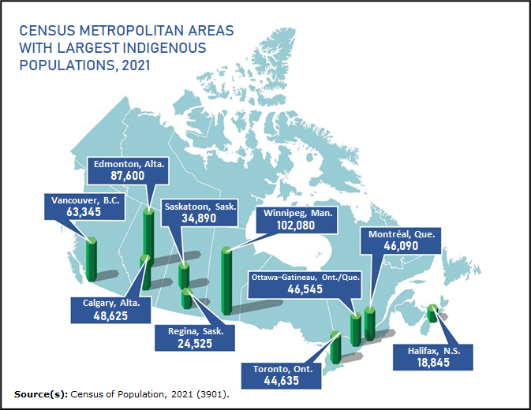
Indigenous population continues to grow in large urban centres

Slide 28
Summary of Indigenous urban demographics
First Nations: In 2021, 420,885 First Nations people lived in a large urban centre, accounting for 40.1% of the total First Nations population. This figure was higher for First Nations people without Registered or Treaty Indian status (59.4%) than it was for status First Nations people (32.6%).
Métis: More than half (55.4%) of Métis lived in a large urban centre in 2021. Winnipeg had the largest Métis population in Canada, followed by Edmonton, Calgary and Vancouver. Combined, these four urban centres accounted for almost one-quarter (24.1%) of the total Métis population in Canada.
Inuit: In 2021, 15.3% of Inuit lived in a large urban centre, up from 13.0% in 2016. There were three urban centres that had an Inuit population of more than 1,000 people: Ottawa–Gatineau (1,730), Edmonton (1,290) and Montréal (1,130).

Slide 29
Age demographics
Continuing a trend observed in previous censuses, the 2021 Census showed that the Indigenous population is younger than the non-Indigenous population. The average age of Indigenous people was 33.6 years compared with 41.8 years for the non-Indigenous population.
Inuit were the youngest of the three groups, with an average age of 28.9 years, followed by First Nations people (32.5 years) and Métis (35.9 years).
There were 459,215 Indigenous children aged 14 years and younger in 2021, accounting for one-quarter (25.4%) of the total Indigenous population. By comparison, 16.0% of the non-Indigenous population was 14 years of age and younger.
Just under two-thirds (65.1%) of Indigenous people were working age (15 to 64 years) in 2021. The share who were close to retirement age —55 to 64 years—was lower for the Indigenous population (17.2%) than for the non-Indigenous population (22%). Future census data may see the Indigenous population accounting for a larger share of the labour force.

Slide 30
Other demographics
Aging: The share of Indigenous people aged 65 years and older continues to grow. From 2016 to 2021, those aged 65 years and older rose from 7.3% to 9.5%.
Gender diversity: Within many Indigenous communities and cultures, there has been a long-held acceptance of gender diversity—often reflected within the term, "Two-Spirit.“ Note: Canada is the first country in the world to provide census data on transgender and non-binary people.
Living conditions:
Past censuses have noted diverse family characteristics, with many living in multigenerational homes alongside parents, grandparents and other relatives (78%).
Grandparents play an important role in raising children, passing down values, traditions and cultural knowledge.
In 2021, 14.2% of Indigenous children lived with at least one grandparent, compared with 8.9% of non-Indigenous children.

Slide 31
Other demographics
Living conditions:
Among all Indigenous children who lived with their grandparents, most (78.0%) lived in a multi-generational home, where at least one parent and at least one grandparent were present. The remaining 22.0% lived in a skip-generation family with at least one grandparent, but no parents present.
The majority (56.0%) of Indigenous children lived in a two-parent household in 2021.
More than one-third (35.8%) of Indigenous children lived in a lone-parent household. Most (79.5%) lived with their mother, while the remainder lived with their father.
Children and youth are over-represented in foster care. Indigenous children accounted for over half (53.8%) of all children in foster care, while nationally, Indigenous children accounted for 7.7% of all children 14 years of age and younger.
In 2020, the Government of Canada instituted the Act respecting First Nations, Inuit and Métis children, youth and families. This legislation sought to reduce the overrepresentation of Indigenous children and youth in foster care and to improve child and family services.

Slide 32
Other demographics
Inadequate or crowded housing:
Because of a number of barriers faced by Indigenous communities, inadequate housing conditions are a significant issue among Indigenous people in Canada. Indigenous people are more likely to live in remote or northern communities, where high costs and limited access to building materials and supplies contribute to the challenges of building or maintaining homes.
For on-reserve First Nations communities, accessing financing to buy, build or renovate housing can be difficult because of the application of the Indian Act, which does not permit the use of property on reserves as collateral in a lending agreement.
Almost one in six Indigenous people (16.4%) lived in a dwelling that was in need of major repairs in 2021, a rate almost three times higher than for the non-Indigenous population (5.7%). Métis were the least likely among Indigenous people to live in a dwelling that was in need of major repairs (10.0%), followed by First Nations people (19.7%) and Inuit (26.2%).

Slide 33
Other demographics
Low income:
Of the 1.8 million Indigenous people living in Canada in 2021, 18.8% lived in a low-income household, compared with 10.7% of the non-Indigenous population.
A downward trend in low income has been observed across Canada and was largely driven by government transfers in response to the COVID-19 pandemic.
Among the three Indigenous groups:
The low-income rate was highest among First Nations people (22.7%). It was particularly high among status First Nations people living on reserve, almost one in three (31.4%) of whom lived in a low-income household.
One in six Inuit (16.6%) and one in eight Métis (12.8%) lived in a low-income household.

Slide 34
Other demographics
Indigenous languages:
Over 70 Indigenous languages were reported in the 2021 Census, with 237,420 Indigenous people reporting that they could speak an Indigenous language well enough to conduct a conversation.
In 2019, the Indigenous Languages Act was signed into law to "support and promote the use of Indigenous languages."
Following this legislative step, the Office of the Commissioner of Indigenous Languages was established with a mandate to support the efforts of Indigenous peoples to reclaim, revitalize, maintain and strengthen Indigenous languages.

Slide 35
Colonization and health
The historic impact of colonization is the single most profound determinant of Indigenous health and well-being. It has presented and continues to present a calculated attack on children’ identity and the indignity of the community and nation.
‘Indigeneity’ is characterized by the relationship to the land, territory, the natural world, dimensions of time, distinct knowledge systems, unique languages, and visions for the sustainable future. Colonization refers to the intentional dismantling of all of these.
Brief synopsis:
1700: Russian, French, Spanish, and British explorers brought diseases – smallpox, tuberculosis, influenza, whooping cough and measles – resulting in thousands of deaths.
British North American Act (1867) and Indian Act (1876) set the stage for assimilation restricting ways of life.

Slide 36
Colonization and health
Brief synopsis:
All traditions and healers were banned until 1950 and beyond.
Over several decades, most cultural norms were lost.
Most devastating were the residential schools, resulting in today’s intergenerational traumas.
Residential schools:
Church-run boarding schools funded by the federal government. Goal was to assimilate children into Canadian society and culture.
The first residential school was established in 1831 in Brampton, Manitoba. The last one closed in 1996 in Punnichy, Saskatchewan.

Slide 37
Colonization and health
Residential schools
The closure of the last residential school was followed by a formal apology in 2008 from Prime Minister Harper in a multi-million dollar settlement, and the current Truth & Reconciliation Commission, and the Residential School Resolution Health Support Programme.
The Indian Act had allowed doctors to put children with tuberculosis into sanitariums, resulting in mistreatment through experimental treatments.

Slide 38
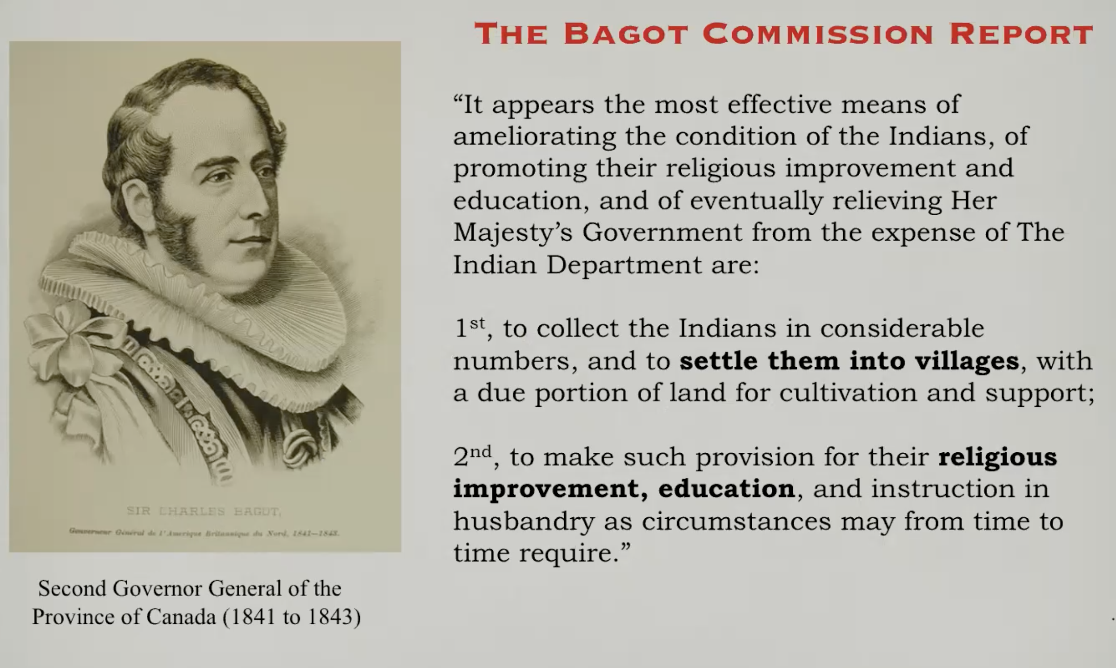

Slide 39
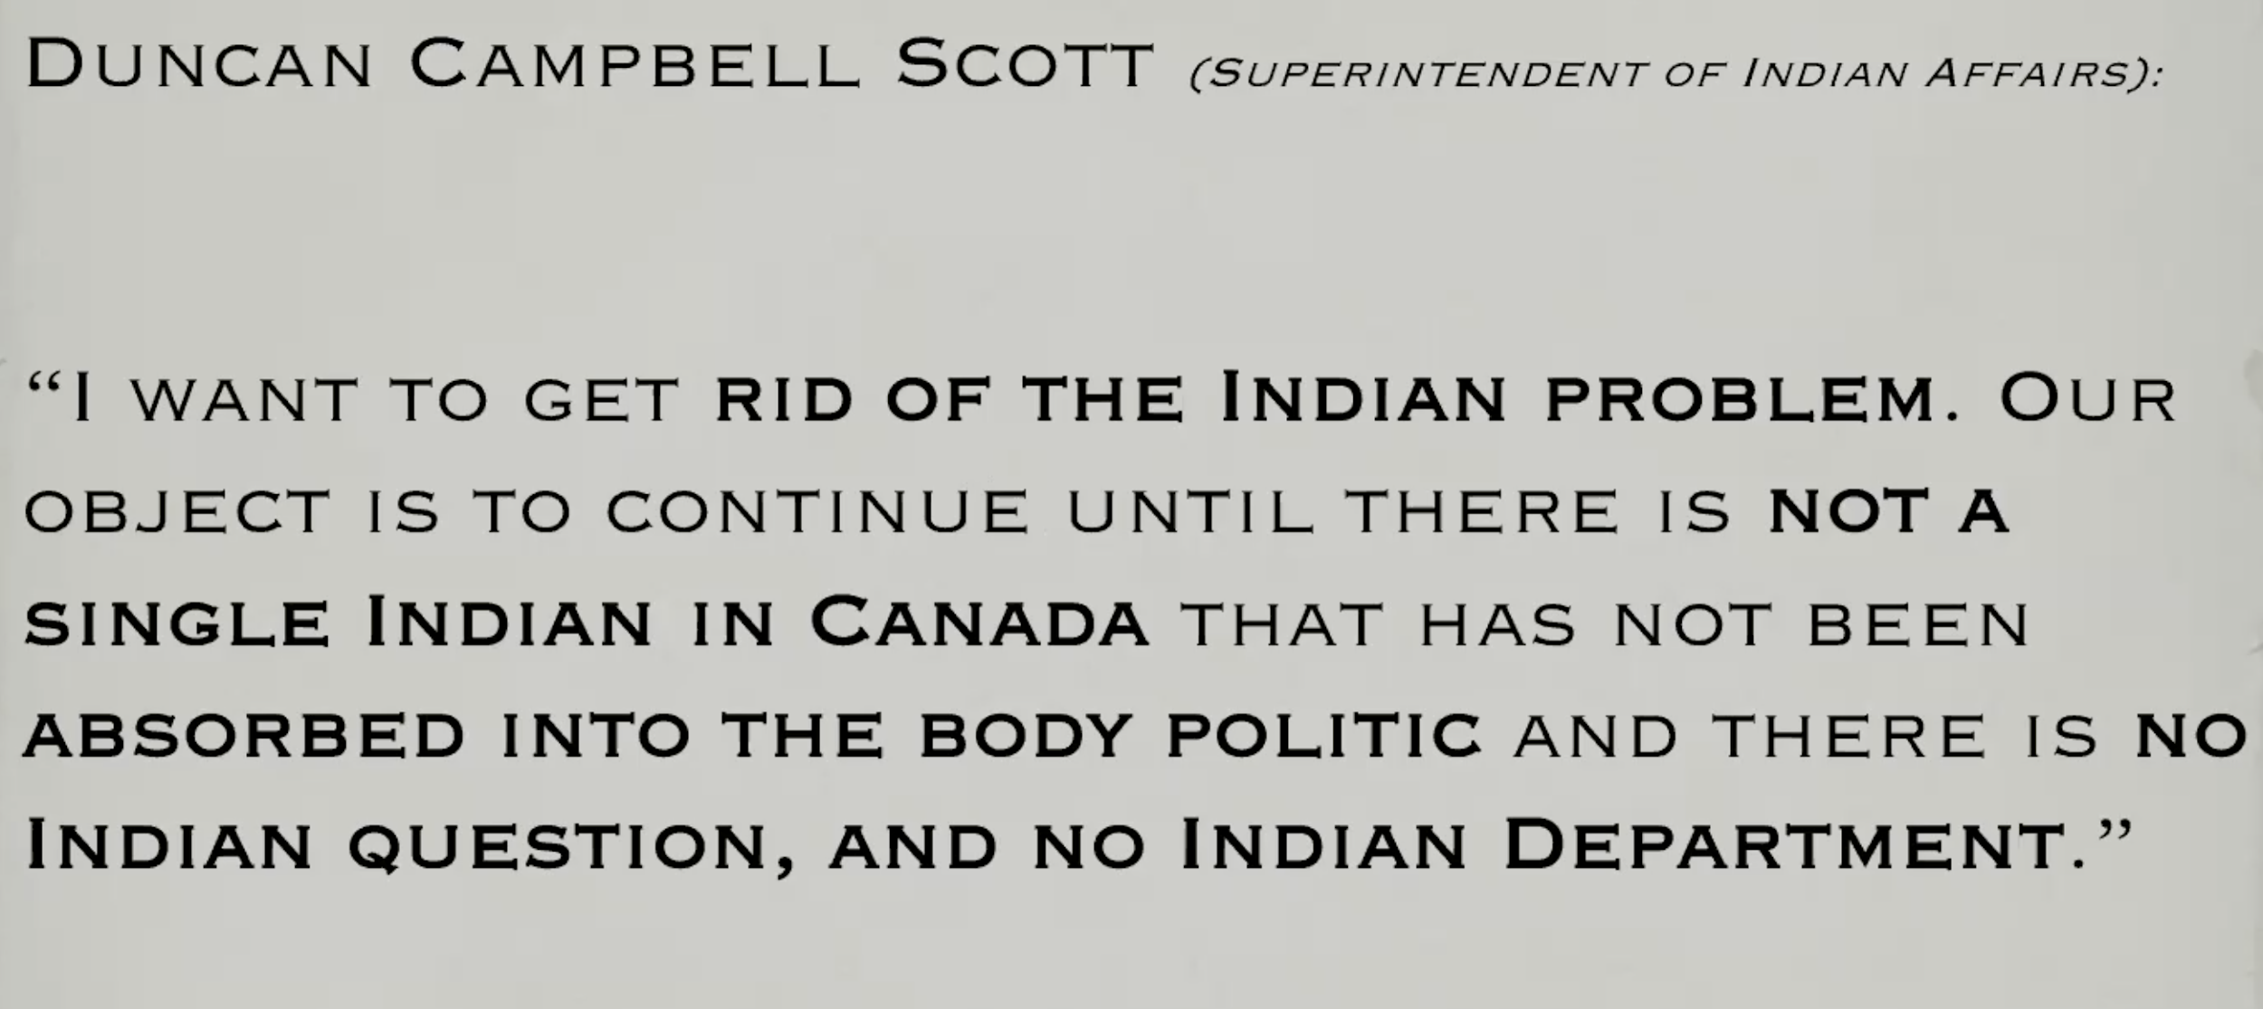

Slide 40
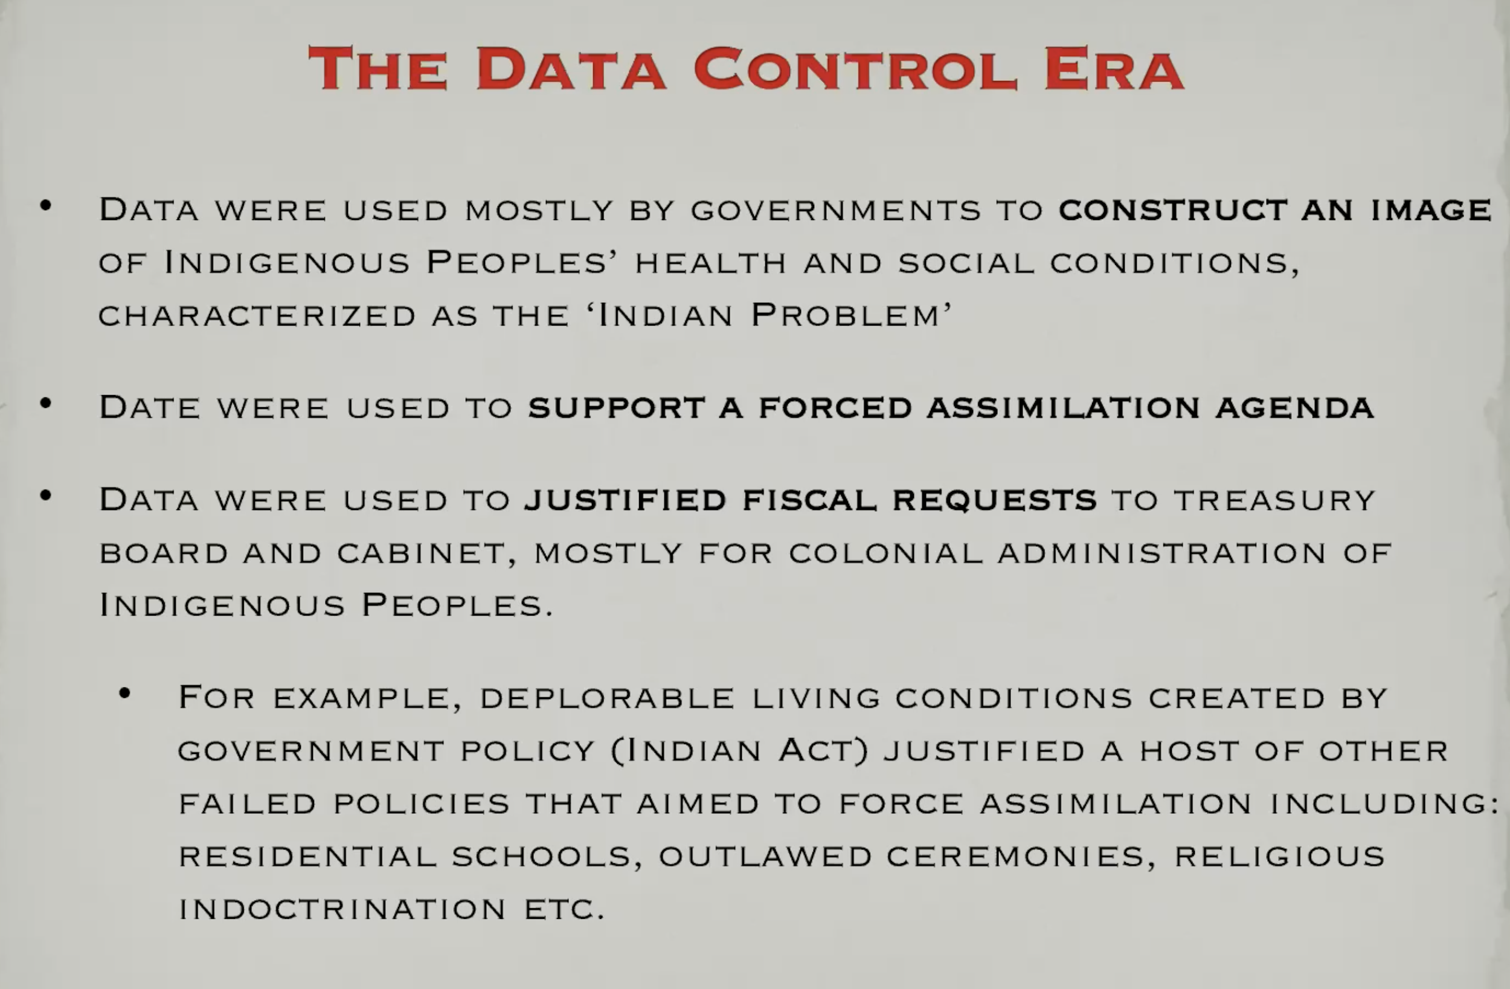

Slide 41
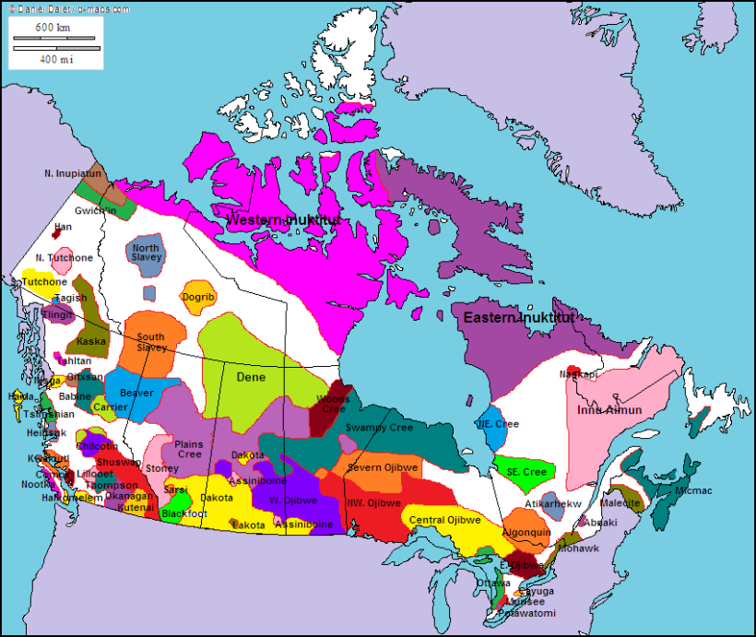
Languages
More than 70 Aboriginal languages were reported in the 2016 Census.
https://sblanguagemaps.wordpress.com/2012/12/23/native-languages-of-canada/

Slide 42
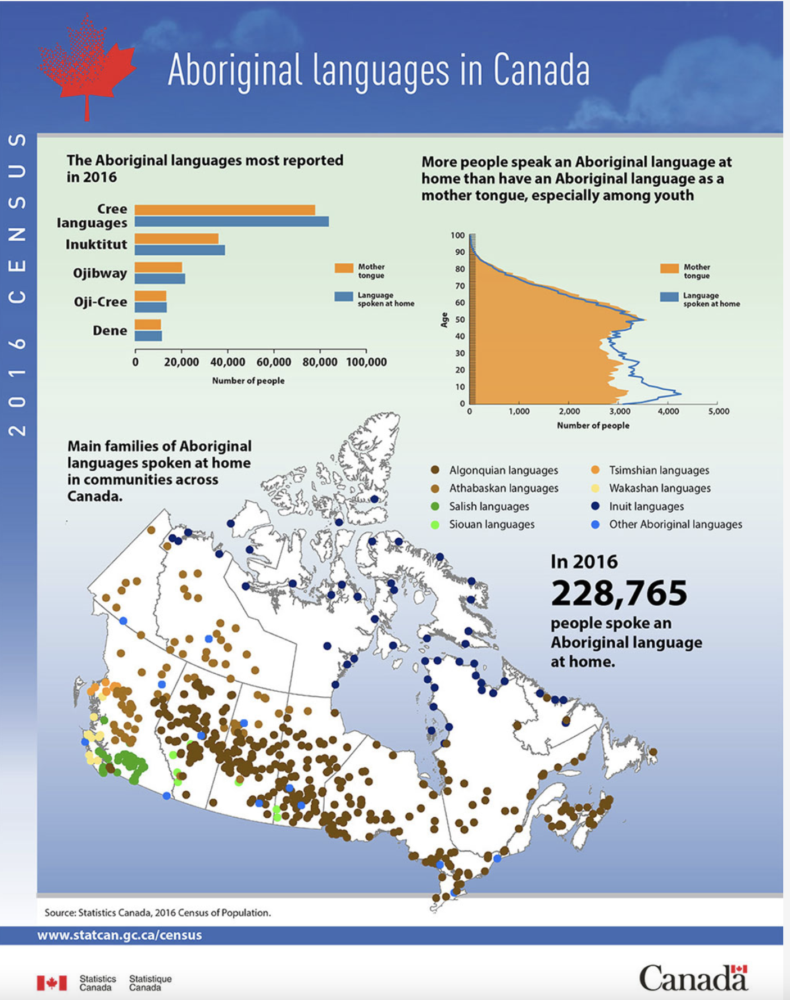
Aboriginal languages
Diversity of languages
In 2016, the 5 most spoken Indigenous languages in Canada were:
Cree (Algonquian language family), close to 100,000 speakers
Inuktitut (Inuit language family), about 40,000 speakers
Ojibway (Algonquian language family), about 25,000 speakers
Oji-Cree (Algonquian language family), about 15,000 speakers
Dene (Athabascan language family), about 10,000 speakers

Slide 43
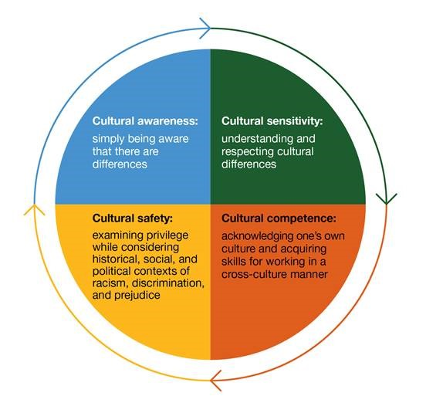
Indigenous Health
Although the population base of First Nations, Inuit, and Métis people is growing and younger than the rest of the population of Canada they have a higher:
Incidence of injury and chronic disease (e.g. obesity, diabetes, cardiovascular disease)
Morbidity and mortality rate in adults and children
Incidence of mental illness, family violence, substance misuse, and suicide

Slide 44
Indigenous health
Chronic health conditions
Chronic disease rates are generally much higher in aboriginal populations.
These include: high blood pressure, asthma, heart disease, tuberculosis, bronchitis, hepatitis, brain injury, diabetes, middle ear infections, cardiovascular disease, chronic obstructive pulmonary disease (COPD), arthritis, renal disease, and digestive disorders.
This is linked to rapid social change, urbanization, socioeconomic change and ultimately erosion of traditional aboriginal cultures, directly linked in turn to the residential school system. An exception: breast cancer is lower.

Slide 45
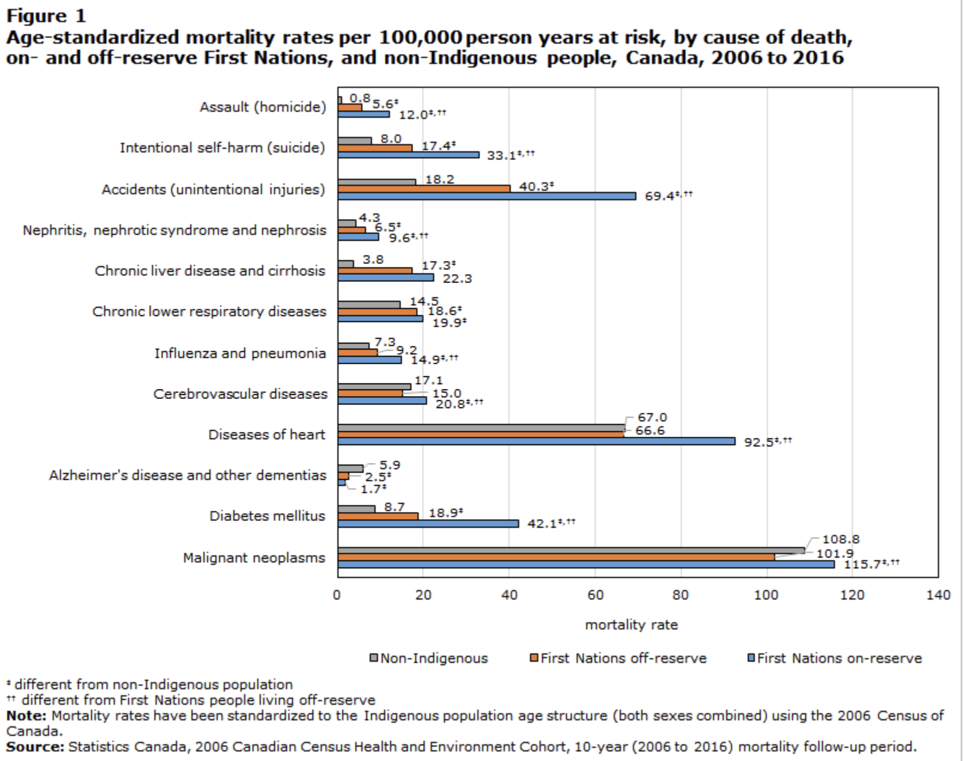

Slide 46
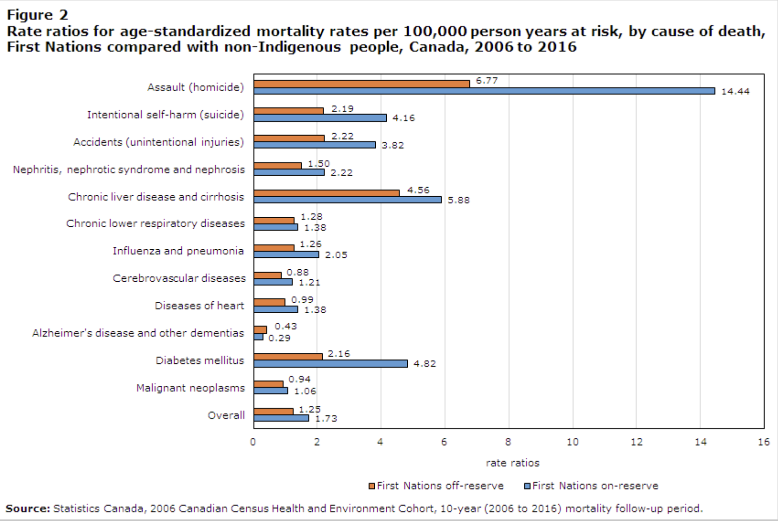

Slide 47
Conclusions
According to the 2006 CanCHEC data, First Nations people showed higher ASMRs (Age-Standardized Mortality Rates) compared with the non-Indigenous population. On-reserve First Nations people showed higher ASMRs than off-reserve First Nations people. The excess mortality of First Nations people, compared with their non-Indigenous counterparts, was caused by death from diabetes, heart diseases, chronic liver disease and cirrhosis, unintentional injuries, and intentional injuries (suicide and assault). The mortality differential between First Nations people and the non-Indigenous population was found to be more pronounced among younger age groups. Overall, provinces and territories showed a similar mortality differential to Canada.
https://www150.statcan.gc.ca/n1/pub/82-003-x/2021010/article/00001-eng.htm

Slide 48
STRUCTURAL DETERMINANTS OF ABORIGINAL PEOPLES’ HEALTH: EXPLORING THE ROOTS
Charlotte Loppie
University of Victoria
Background image retrieved from: http://standrewschristianchurch.org/wp-content/uploads/2015/02/Roots.png

Slide 49
Which end is up?
a descending causal model is often used to explore structural determinants of health
describes structural determinants as ‘upstream’ forces - creating conditions that flow down to affect population health.

Slide 50
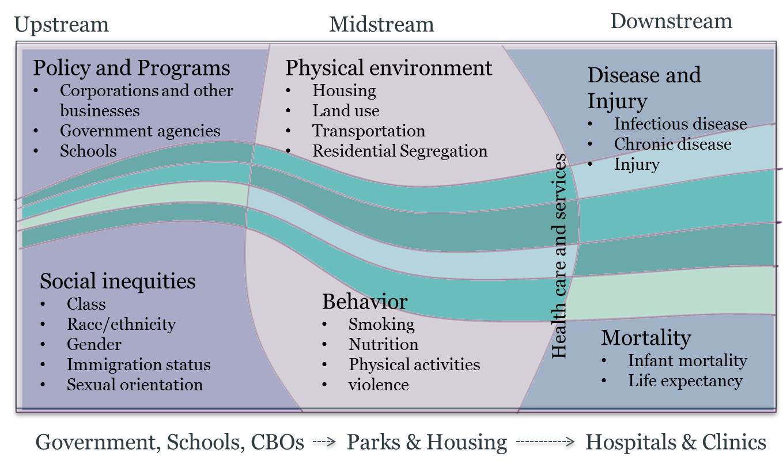
http://www.ci.richmond.ca.us/images/pages/N2575/Upstream%20v%20Downstream%20Dec%202012.jpg

Slide 51

http://ishareimage.com/colorful-tree-with-roots.asp

Slide 52
Why the tree?
Trees are a familiar part of the natural world.
Trees represent complex, interconnected systems – yet create a simple metaphor.
The tree metaphor allows us to focus on systems within an overall structure.
The leaves of a tree typically denote its wellness, yet disease often originates in the roots.

Slide 53
Structure
“the arrangement of and relations between the parts or elements of something complex.”
Oxford dictionary
Notes:
No one can argue that Aboriginal health is not ‘something complex’.

Slide 54
Immediate, Systemic, & Structural Environments
IMMEDIATE (STEM) ENVIRONMENTS:
Individual and community opportunities and resources in/sufficient to promote and/or support human health (physical, emotional, mental and spiritual).
SYSTEMIC (CORE) ENVIRONMENTS:
Institutions of education, employment, health, and governance in/sufficient to promote and/or support healthy immediate environments.
STRUCTURAL (ROOT) ENVIRONMENTS:
Social, political, and economic in/sufficient to promote and/or support healthy systemic environments.

Slide 55
Aboriginal epistemology – view of health
Generally, epistemology refers to one’s world view, to an understanding of nature, historically following the scientific biomedical approach to health.
Traditional aboriginal cultures do not follow the biomedical approach to health.
There is no sharp distinction between physical and spiritual. Health is seen as a balance between different forces acting in the world.
Health is maintained through the authority of the community and tradition through consensus.
The health of the individual is seen in the context of the health of family and community.

Slide 56
Aboriginal epistemology
Epistemological accommodation
The process where the aboriginal and health care provider must accommodate each other’s world views. For example, Inuit in northern Quebec and others work together to prevent diabetes; both use techniques and knowledge of biomedicine but approaches to healthcare are rooted in their own cultures.
Support culturally appropriate care.
Practice cultural safety. Create an environment that is culturally safe for the patient without compromising code of ethics and practice. Techniques of biomedicine are integrated into holistic epistemology of health that exists within aboriginal world view.

Slide 57
Indigenous Health Care
No consensus on the best approach
Locally controlled and managed gaining favour
Access and universality pose the greatest challenge
Health Centres well equipped by most standards, however too often individuals need to leave community for treatment
Retaining medical and nursing staff is a challenge
Health centres are incorporating traditional healing practices into their programs

Slide 58
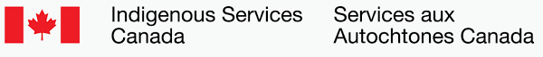

Works collaboratively with partners to improve access to high quality services for First Nations, Inuit and Métis. Our vision is to support and empower Indigenous peoples to independently deliver services and address the socio-economic conditions in their communities.

Slide 59
Complex patchwork
Indigenous peoples are included in the per capita allocations of funding from the federal fiscal transfer and are entitled to access insured provincial and territorial health services as residents of a province or territory.
Indigenous Services Canada funds or directly provides services for First Nations and Inuit that supplement those provided by provinces and territories, including primary health care, health promotion and supplementary health benefits.

Slide 60
Indigenous services Canada
Funds or directly provides certain health care services to First Nations communities and funds the provision of certain community health programs for Inuit living in Inuit Nunangat.
Funds non-insured health care benefits to eligible First Nations and recognized Inuit regardless of where they live in Canada.
Federal funding for First Nations and Inuit health services is provided through annual appropriations and is subject to discretionary increases or reductions by the federal government.
For Métis, off-reserve First Nations and non-status First Nations, services and benefits are primarily provided for by provinces and territories.

Slide 61
Provincial and territorial legislation
Have enacted legislative provisions recognizing matters such as the value and role of Indigenous groups in the planning and delivery of health services in their communities or the importance of culture and traditional healing practices.
Importance of partnerships with indigenous groups
Seeks to identify and address the health needs of particular groups
Recognizes the values and role of indigenous groups in planning and delivery
Ensures indigenous representation on various health-related boards, committees and regional health authorities

Slide 62
Provincial and territorial legislation
Provides that self-government agreements shall prevail in conflict
Includes provisions related to traditional healing practices or recognition that indigenous midwives should be exempt from control specified under the code of professions; Ontario further extends this to traditional healers
States that culture should be taken into account during mental health assessments, for eg. Consultation with elder or cultural advisor
Exempts traditional indigenous spiritual, cultural practices or ceremonies from regulations under tobacco control acts
References the role of indigenous people in health information, privacy and management and/or notes that the province can disclose health information to an indigenous government for development of health programs and services
Includes provisions to negotiate additional jurisdiction or provisions to make bylaws to promote the health, safety and welfare of the residents within a defined area and to enhance Indigenous control over issues such as health

Slide 63
Self-governing First Nations, Inuit and Metis governments
Canada recognizes that First Nations, Inuit and Métis have an inherent right of self-government protected by section 35 of the Constitution Act, 1982.
Canada recognizes that First Nations, Inuit and Métis have the right to govern themselves in relation to matters that are internal to their communities, integral to their unique cultures, identities, traditions, languages and institutions, and with respect to their special relationship to their land and their resources.

Slide 64
Negotiated agreements
An Indigenous government may make laws and/or has jurisdiction with respect to health services.
An Indigenous government may make laws and/or has jurisdiction with respect to traditional healing services, including maintenance of the practice and training of persons providing the traditional health services (for example, traditional healers).
Self-government negotiations shall address, and self-government agreements may include, matters related to health.
An Indigenous government is responsible for the administration of health services.

Slide 65
Promising models and emerging pathways
1979 Indian Health Policy and the 1988 Health Transfer Policy framework, First Nations and Inuit have realized enhanced control of health services.
While self-government and land claim agreements have also created unique models and can set out law-making authority in many areas including health, there are many emerging trends in Indigenous health transformation, jurisdictional coordination and collaborative processes, which are helping to provide some coherence to Canada's complex health care system.
In British Columbia, a new era in First Nations health was forged in 2011 with the signing of the British Columbia Tripartite Framework Agreement in First Nation Health Governance. This tripartite agreement created a new province-wide First Nations Health Authority in 2013 with a direct leadership role for the design, delivery and management of health programs and services for First Nation communities in British Columbia. The tripartite partners work closely together to improve health outcomes for British Columbia First Nations communities through a First Nations health governance structure that addresses health and other inequities experienced by First Nations and works to identify opportunities for stronger coordination with provincial programs and services.

Slide 66
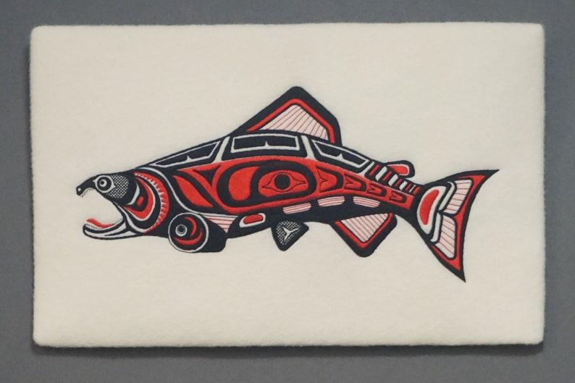
Indigenous Health
Objectives: Part 2
Describe the Truth and Reconciliation Commission and its focus on health with recommendations and actions
Describe the role of the First Nations Health Authority
Describe principles and protocols, indigenous epistemology and implications for research in health information science
Describe the OCAP principles for data governance of indigenous peoples

Slide 67
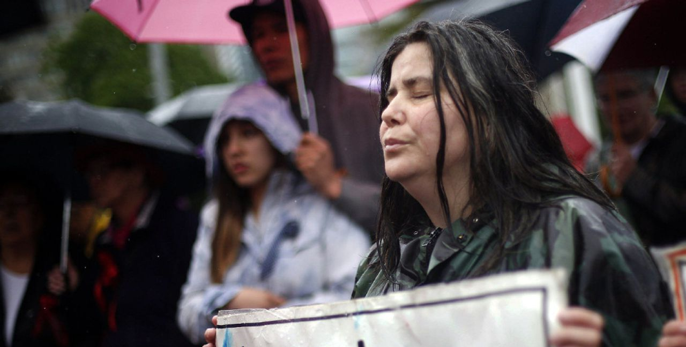

Mandated to: “reveal to Canadians the complex truth about the history and the ongoing legacy of church-run residential schools…” and, “guide and inspire a process of truth and healing, leading toward reconciliation within Aboriginal families, and between Aboriginal peoples and non-Aboriginal communities, governments, and Canadians generally”
(See: The Reconciliation Manifesto: Recovering the Land, Rebuilding the Economy. Arthur Manuel & Grand Chief Ronald Derrickson, 2017.)

Slide 68
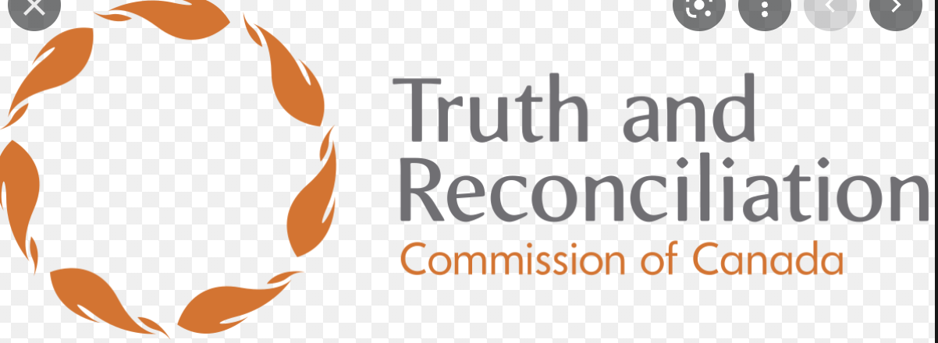
Truth and Reconciliation Commission
Acknowledge current state of Aboriginal health is a result of previous Canadian government policies
Establish measurable goals to identify and close gaps in health outcomes
Recognize, respect and address the distinct health needs of the Metis, Inuit and off reserve
Provide sustainable funding for existing and new Aboriginal healing centres

Slide 69
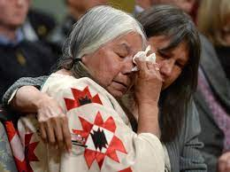
Truth and Reconciliation Commission
Recognize the value of Aboriginal healing practices and use them in treatment
Increase Aboriginal professionals, retain them in Aboriginal communities, provide cultural competency training for all health-care professionals
Require medical and nursing students to take a course in Aboriginal health issues

Slide 70
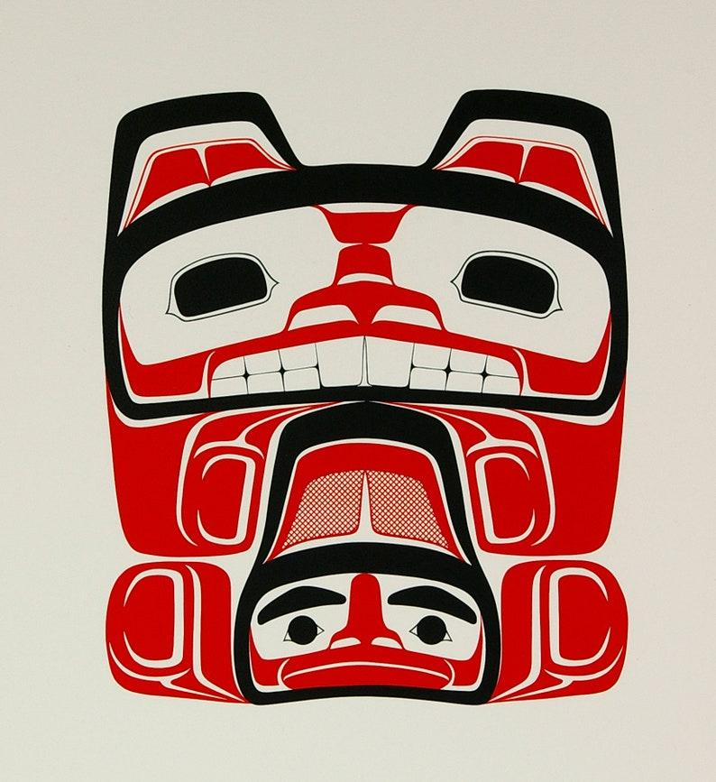
Recommendations
Truth and Reconciliation Commission released an executive summary in June 2015 with 94 recommendations — referred to as “Calls to Action” — which cover the broad themes of child welfare, education, language and culture, health and justice.

Slide 71
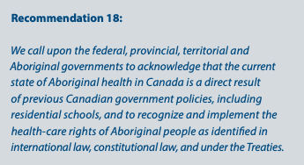
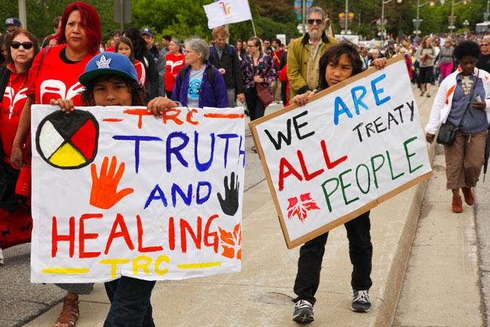
Recommendations 18 – 24 and 55
https://www.healthcarecan.ca/wp-content/themes/camyno/assets/document/IssueBriefs/2016/EN/TRCC_EN.pdf

Slide 72
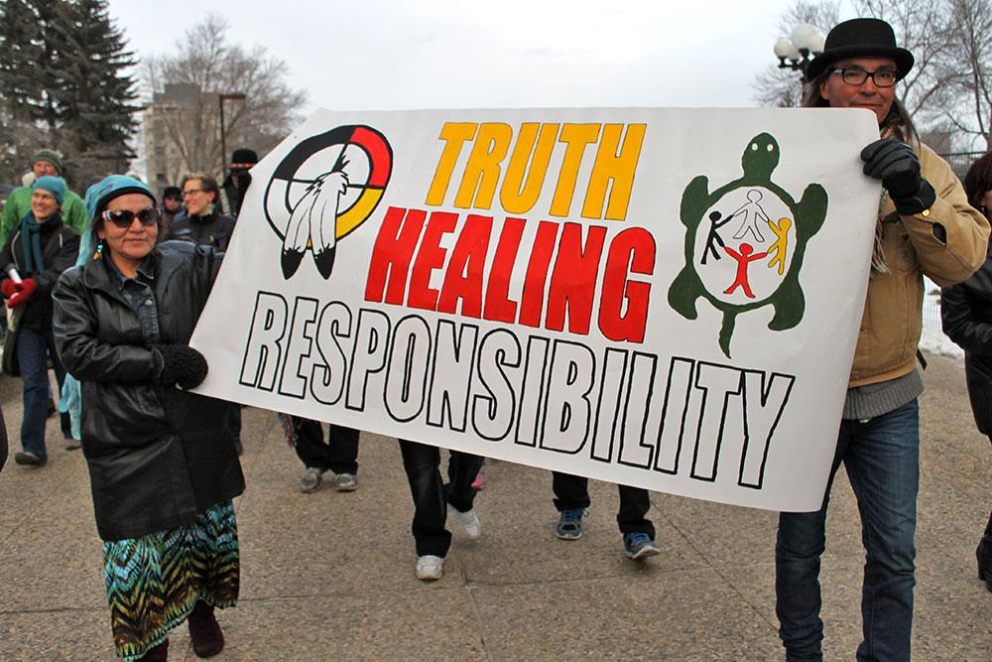
Actions required
Reframing
Acknowledging
Recognizing
Ensuring
Reframing the discussion of Indigenous health inequities and differences in care from “patient blaming” to “system enabling”;
Acknowledging the presence of underlying ideologies of racism and colonization;
Recognizing that widespread apathy and disdain can be common when addressing First Nations, Métis and Inuit health gaps;
Ensuring messages related to education, research and service delivery are consistent with the Commission’s message that the health gaps are the result of policy choices past and present;
https://www.healthcarecan.ca/wp-content/themes/camyno/assets/document/IssueBriefs/2016/EN/TRCC_EN.pdf

Slide 73
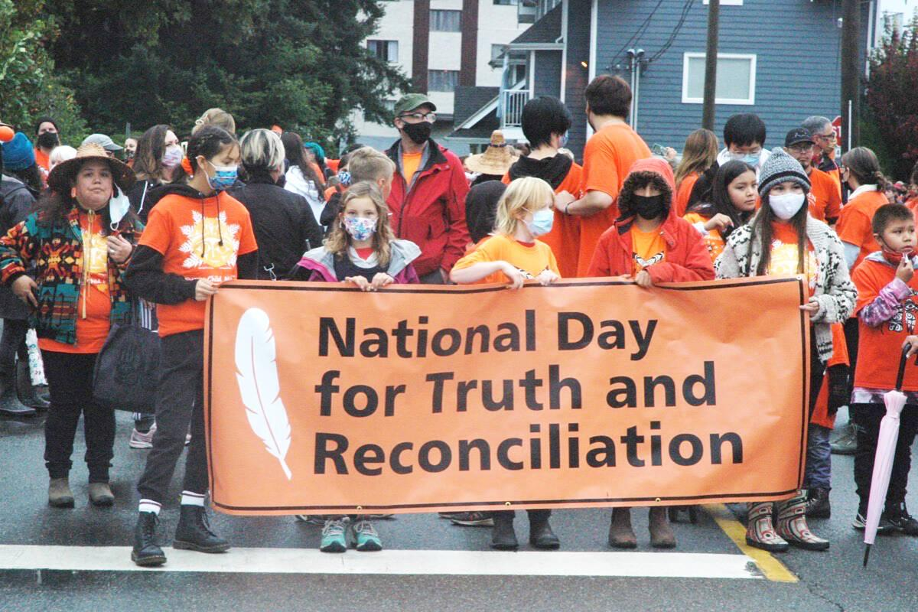
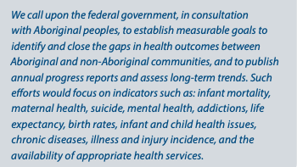
Recommendation 19

Slide 74
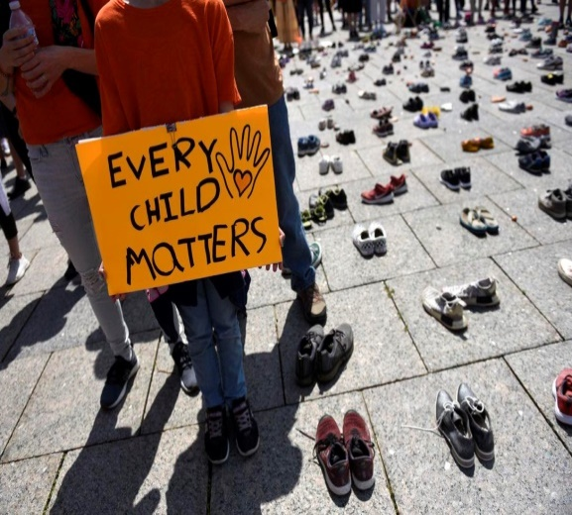
Actions
Commitment to “OCAP” - First Nations principles of Ownership, Control, Access, and Possession – which assert First Nations’ control over data collection processes, and that they own and control how this information can be used in health research.
Facilitating dialogue, contribute expertise and collaboratively develop systems to produce high quality, robust health data that appropriately respect the governance rights of Indigenous people;
Ensuring that research engagement includes the requirement of equitable benefit for First Nations, Métis and Inuit people in Canada as evaluated by representative organizations;
Advocating for the Canadian Institute for Health Information (CIHI) to better facilitate collection, analysis and dissemination of this data; and,
Supporting the recommendation from the 2015 report of the Advisory Panel on Health Care Innovation (chaired by Dr. David Naylor) to create a First Nations Health Quality Council which would lead this work.

Slide 75
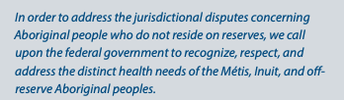
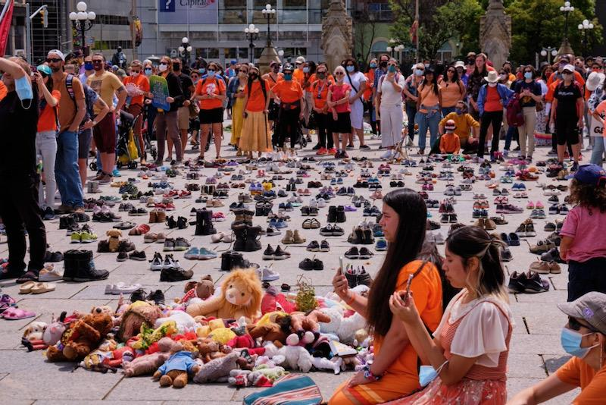
Recommendation 20

Slide 76
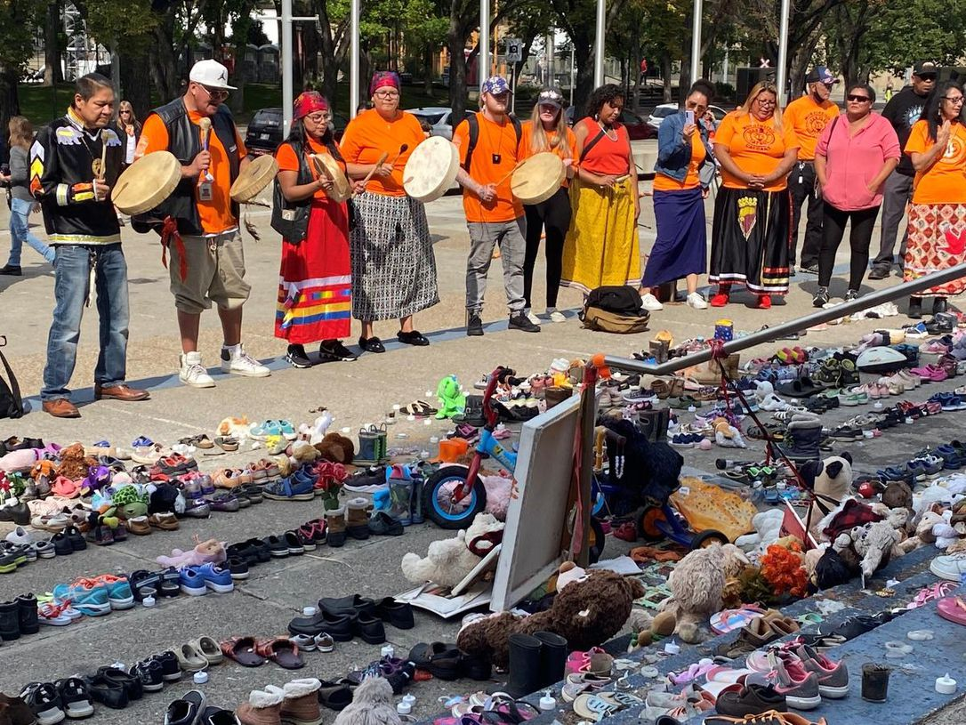
Actions
Renew emphasis on primary care services
Implementation of Jordan’s principle across health services
Engaging all levels of government to ensure seamless transition between federally and provincially funded healthcare that is patient and family centered

Slide 77
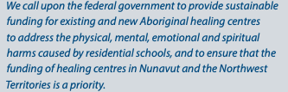
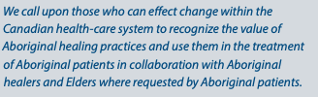
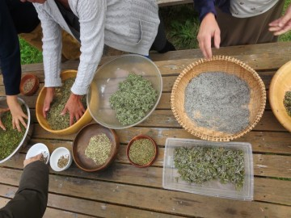
Recommendation 21 & 22

Slide 78
Actions
Advocating for parallel support of Indigenous traditional medicine approaches to healing;
Working with traditional healers to develop respectful ways to teach learners as well as practicing health care providers on how to work with traditional healers or people who are using traditional healing methods - this may include accreditation; and,
Developing community partnerships between First Nations communities and health organizations to ensure inclusion of traditional healing in the primary care models in ways that are respectful, responsive, and directed by First Nations communities and traditional healers.

Slide 79
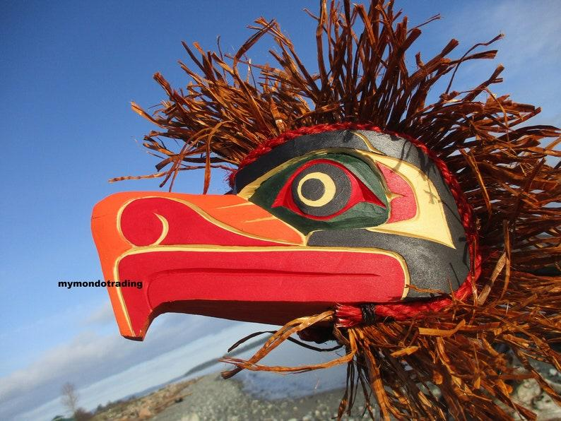
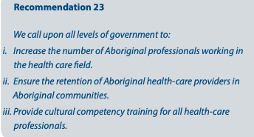
Recommendation 23

Slide 80
Actions
Establishing specific targets and timelines for the admission and graduation of First Nations, Métis and Inuit health professionals in all of the Colleges;
Assessing, developing, and resourcing pipeline activities to successfully achieve a representative workforce;
Exploring partnership opportunities to improve the retention of Aboriginal health care providers in Aboriginal health regardless of the location of practice;
Recommending that all health care professionals who have contact with learners should receive cultural safety training and that a variety of methods and opportunities should be available; and,
Further developing remediation processes for classroom and clinical teachers that are safe for learners who experience or witness culturally unsafe care or teaching.

Slide 81
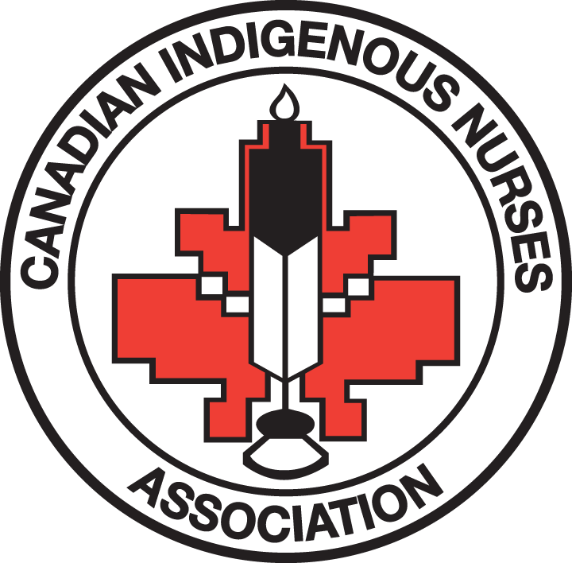
Recommendation 24
We call upon medical and nursing schools in Canada to require all students to take a course dealing with Aboriginal health issues, including the history and legacy of residential schools, the United Nations Declaration on the Rights of Indigenous Peoples, Treaties and Aboriginal rights, and Indigenous teachings and practices. This will require skills-based training in intercultural competency, conflict resolution, human rights, and anti-racism.

Slide 82
Actions
Including the history and legacy of residential schools, the United Nations Declaration on the Rights of Indigenous Peoples, and Treaties and Aboriginal rights as foundational knowledge for all health professionals, administrators and health workers;
Having a mandatory course on Indigenous peoples as a requirement for work in the health system;
Creating support strategies for faculty members, staff, and volunteers who lead the teaching sessions and who continue to be subjected to violence and backlash from learners and sometimes from colleagues within the Faculty; and,
Advocating for by-law and licensing requirements that require specific competencies in First Nations, Métis and Inuit health as described in this Call to Action.

Slide 83
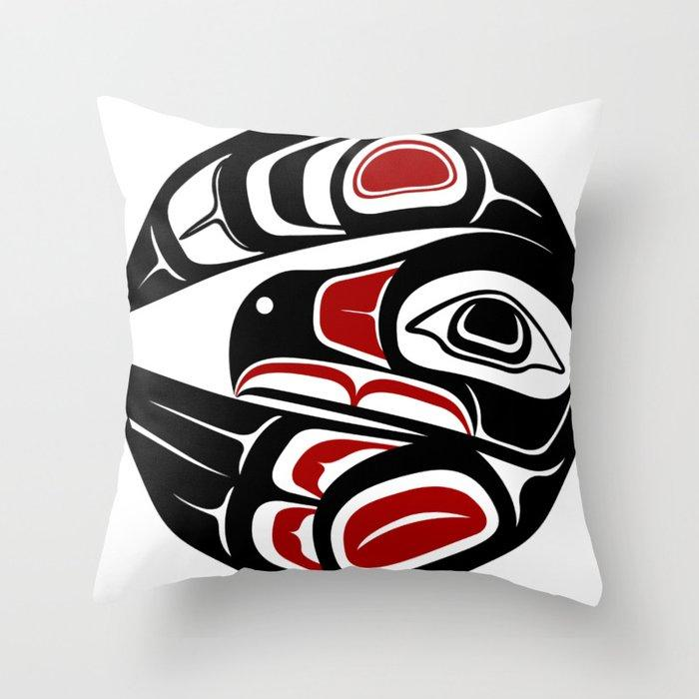
Recommendation 55
We call upon all levels of government to provide annual reports or any current data requested by the National Centre for Reconciliation so that it can report on the progress towards reconciliation. The reports or data would include, but not be limited to:
Progress on closing the gaps between Aboriginal and nonAboriginal communities in a number of health indicators such as: infant mortality, maternal health, suicide, mental health, addictions, life expectancy, birth rates, infant and child health issues, chronic diseases, illness and injury incidence, and the availability of appropriate health services.

Slide 84
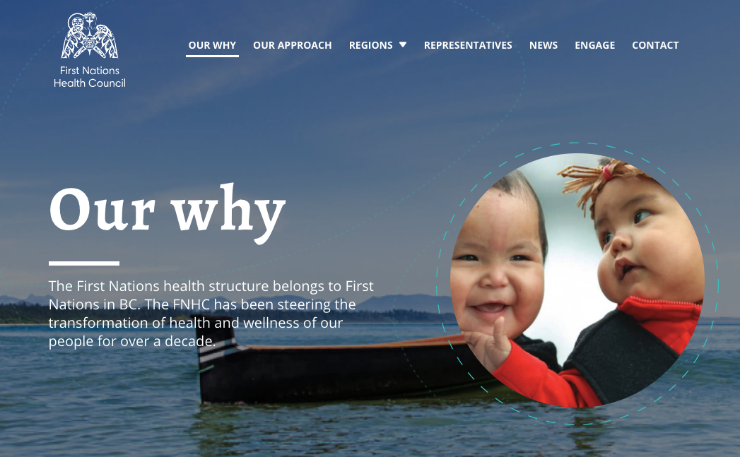
Actions
Establishing reconciliation plans as part of broader strategic plans within health care and academic organizations;
Advocating for a national Indigenous health strategy that includes this reporting goal; and,
Supporting the recommendation from the 2015 report of the Advisory Panel on Health Care Innovation (chaired by Dr. David Naylor) to create a First Nations Health Quality Council which would lead this work.

Slide 85
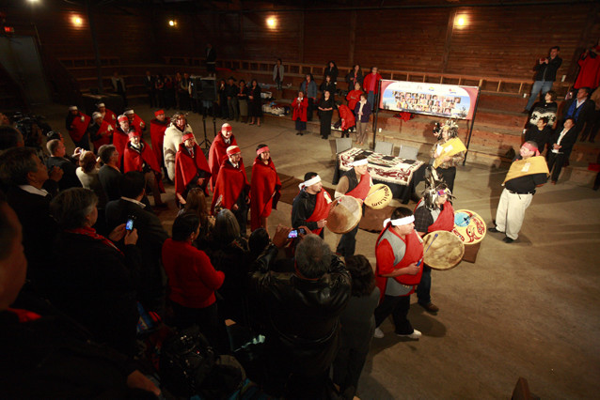
First Nations Health Authority
Health and wellness partner to over 200 diverse First Nations communities and citizens
2013 took over governance responsibility services delivered by Health Canada
Address service gaps through new partnerships, closer collaboration, health systems innovation, reform and redesign of programs

Slide 86

Champion of culturally safe practices
Actively works with its health partners to embed cultural safety and humility into health service delivery and improve health outcomes for First Nations people
Cultural safety is an outcome based on respectful engagement that recognizes and strives to address power imbalances inherent in the health care system. It results in an environment free of racism and discrimination, where people feel safe when receiving health care.
Cultural hum​ility is a process of self-reflectio​n to understand personal and systemic biases and to develop and maintain respectful processes and relationships based on mutual trust. Cultural humility involves humbly acknowledging oneself as a learner when it comes to understanding another’s experience.
https://www.fnha.ca/wellness/wellness-and-the-first-nations-health-authority/cultural-safety-and-humility

Slide 87
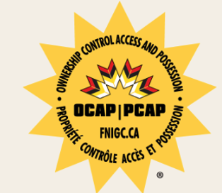
First Nations principles about data
The First Nations principles of OCAP® establish how First Nations’ data and information will be collected, protected, used, or shared. Standing for ownership, control, access and possession, OCAP® is a tool to support strong information governance on the path to First Nations data sovereignty. Given the diversity within and across Nations, the principles will be expressed and asserted in line with a Nation’s respective world view, traditional knowledge, and protocols.

Slide 88
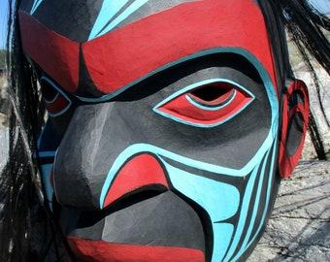
Ownership
Ownership refers to the relationship of First Nations to their cultural knowledge, data, and information. This principle states that a community or group owns information collectively in the same way that an individual owns his or her personal information.

Slide 89
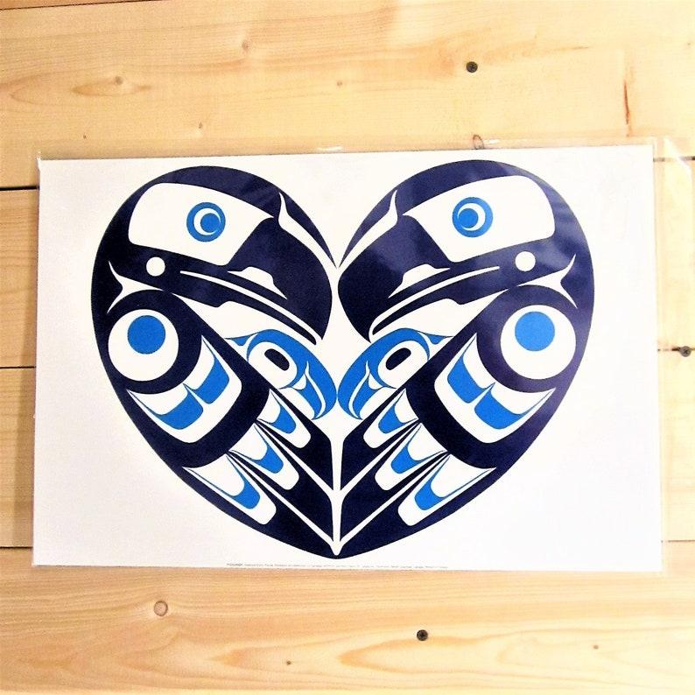
Control
Control affirms that First Nations, their communities, and representative bodies are within their rights in seeking to control over all aspects of research and information management processes that impact them. First Nations control of research can include all stages of a particular research project-from start to finish. The principle extends to the control of resources and review processes, the planning process, management of the information and so on.

Slide 90
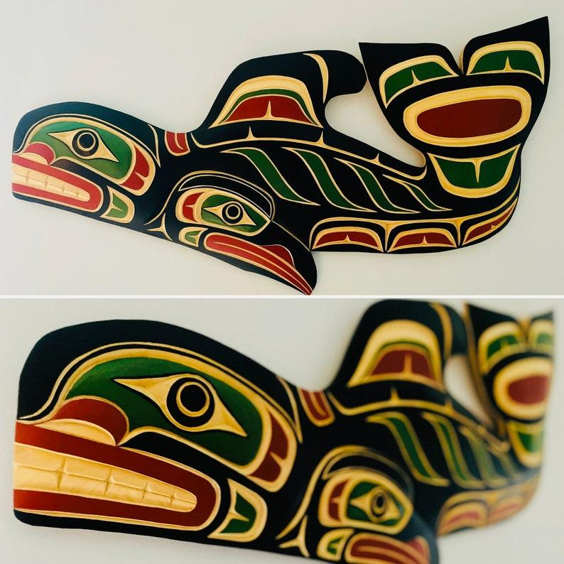
Access
Access refers to the fact that First Nations must have access to information and data about themselves and their communities regardless of where it is held. The principle of access also refers to the right of First Nations’ communities and organizations to manage and make decisions regarding access to their collective information. This may be achieved, in practice, through standardized, formal protocols.

Slide 91
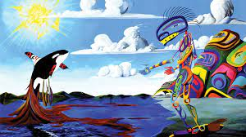
Possession
Possession While ownership identifies the relationship between a people and their information in principle, possession or stewardship is more concrete: it refers to the physical control of data. Possession is the mechanism by which ownership can be asserted and protected.
Further information on OCAP can be found at. https://fnigc.ca/online-library/

Slide 92
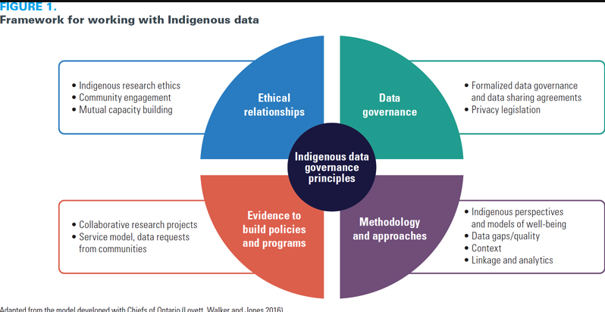
Framework for working with indigenous data
https://www.longwoods.com/content/25431/walking-the-path-together-indigenous-health-data-at-ices

